Slide 1
Lecture 06
Linear Discriminant Analysis (LDA)

Slide 2
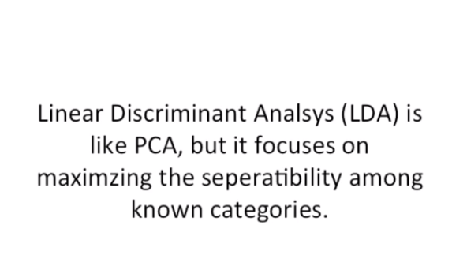
Linear Discriminant Analysis (LDA)
In addition to finding the component axes that maximize the variance of our data (PCA), we are additionally interested in the axes that maximize the separation between multiple classes (LDA).

Slide 3
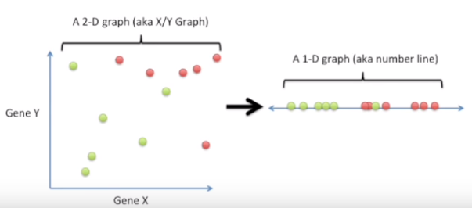
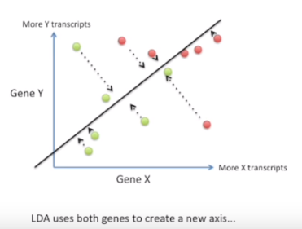
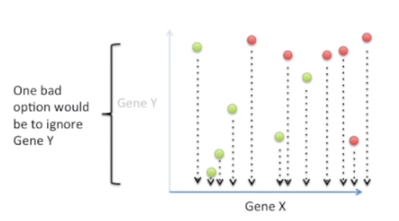
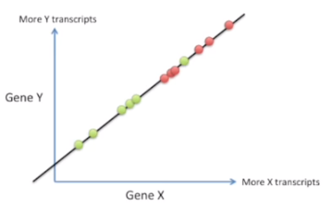
Linear Discriminant Analysis (LDA)

Slide 4
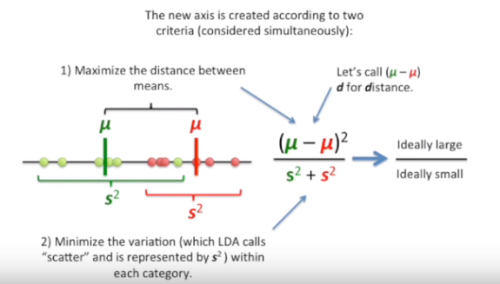
How LDA creates new axis?

Slide 5
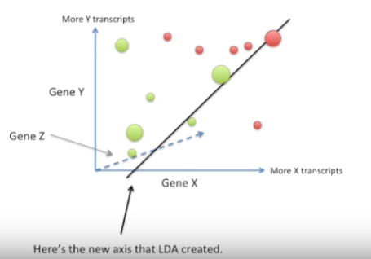
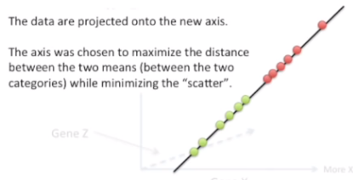
LDA with 3 Genes

Slide 6
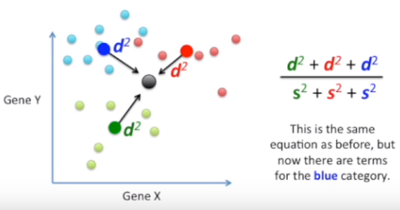
LDA for 3 Category

Slide 7
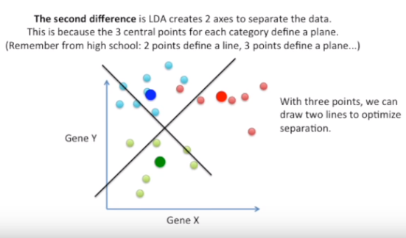
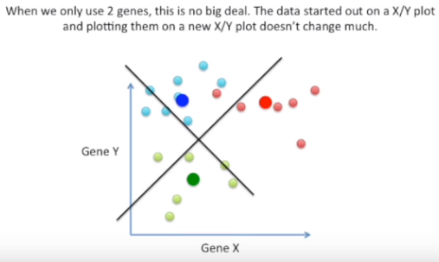
LDA for 3 Category

Slide 8
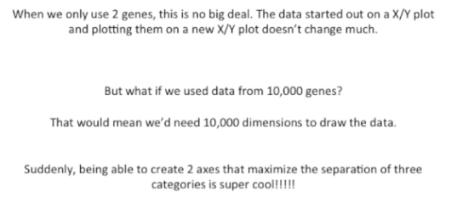
LDA for 3 Category

Slide 9
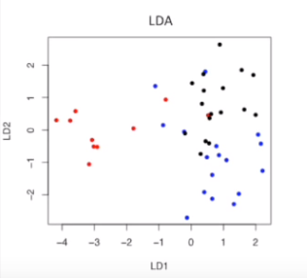
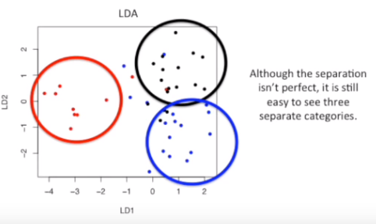
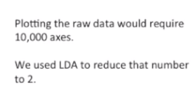
LDA for 3 Category and 10000 Genes

Slide 10
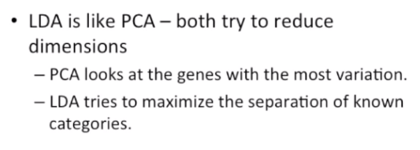
Comparing LDA to PCA

Slide 11
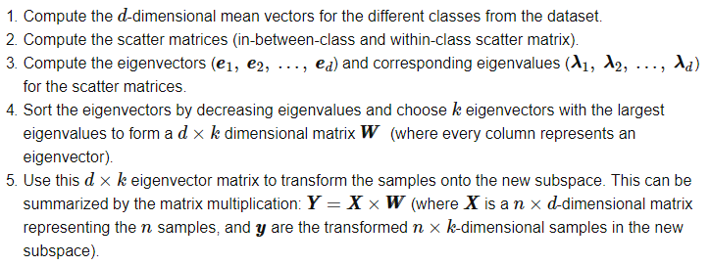
Summarizing the LDA approach in 5 steps

Slide 12
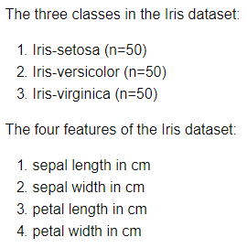
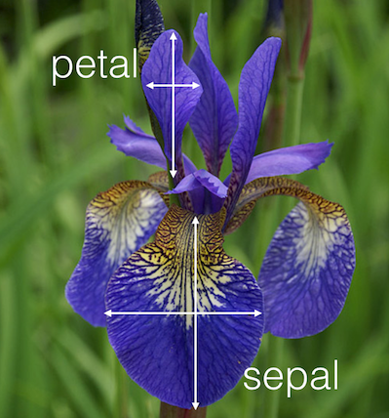
LDA with Example

Slide 13
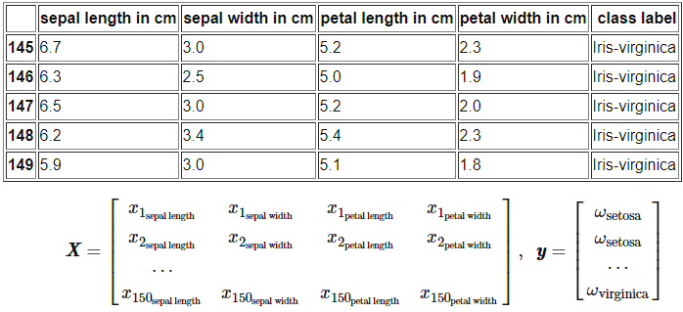
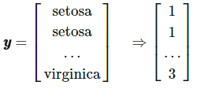
LDA with Example

Slide 14
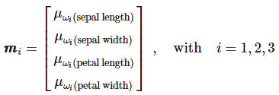
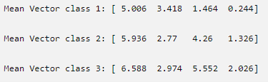
Step 1: Computing the d-dimensional mean vectors

Slide 15
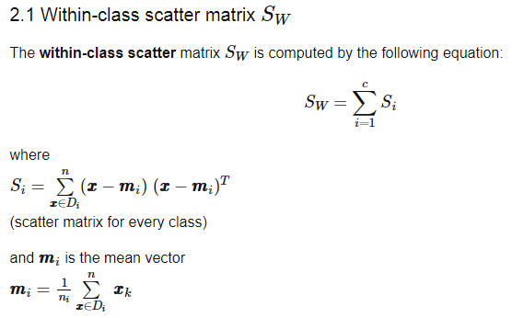
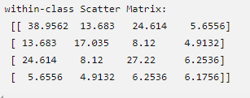
Step 2: Computing the Scatter Matrices

Slide 16
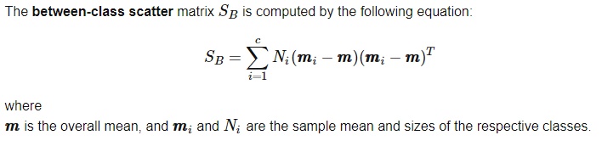
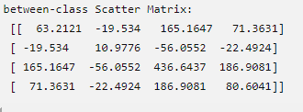
Step 2: Computing the Scatter Matrices

Slide 17

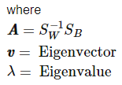
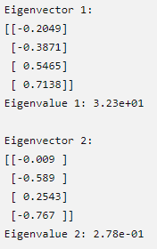
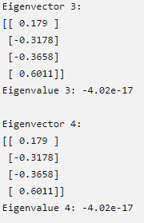

Slide 18
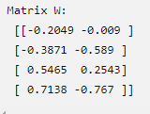
Step 4: Selecting linear discriminants for the new feature subspace
4.1. Sorting the eigenvectors by decreasing eigenvalues
Sorted eigenvalues:
32.2719577997, 0.27756686384, -4.02e-17, -4.02e-17
4.2. Choosing k eigenvectors (usually c-1) with the largest eigenvalues

Slide 19

Step 5: Transforming the samples onto the new subspace
We will use the 4×2-dimensional matrix W that we just computed to transform our samples onto the new subspace via the following equation.
where X is a n×d-dimensional matrix representing the n samples, and Y are the transformed n×k-dimensional samples in the new subspace

Slide 20
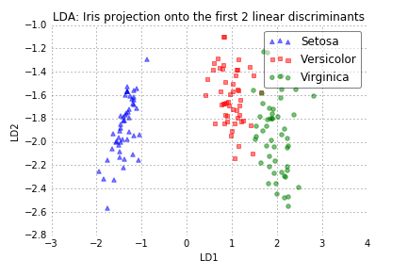
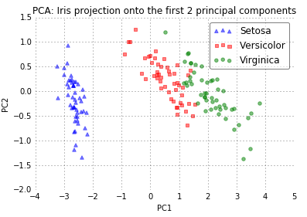
LDA and PCA Projections

Slide 21
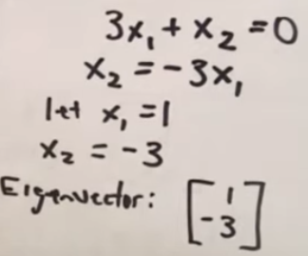

Finding eigenvector and eigenvalue

Slide 22
References
1. https://www.youtube.com/watch?v=azXCzI57Yfc
2. https://www.youtube.com/watch?v=T26-kN54gJY
3. https://www.youtube.com/watch?v=moqPyJQHR_s
4. http://www.saedsayad.com/lda.htm
5. https://medium.com/journey-2-artificial-intelligence/lda-linear-discriminant-analysis-using-python-2155cf5b6398
6. https://en.wikipedia.org/wiki/Linear_discriminant_analysis
7. http://sebastianraschka.com/Articles/2014_python_lda.html
8. https://scikit-learn.org/stable/modules/generated/sklearn.discriminant_analysis.LinearDiscriminantAnalysis.html

